Slide 1



DV!
View in Power BI
Last data refresh:
18/07/2023 07:03:29 UTC
Downloaded at:
18/07/2023 09:08:14 UTC

Slide 2
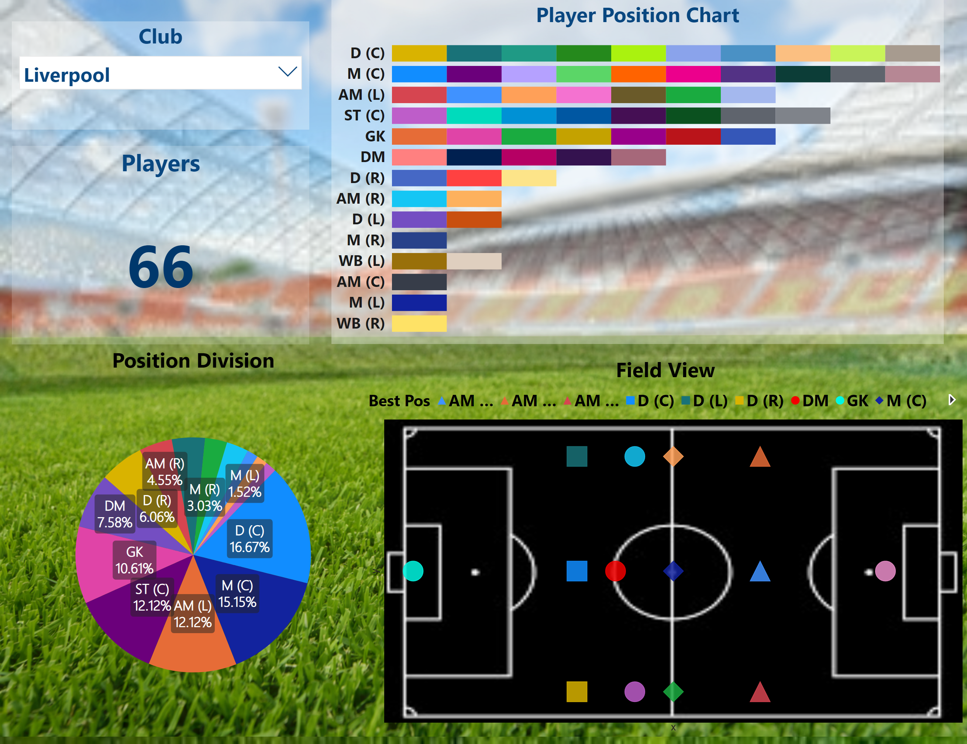
Notes:
Position Division
No alt text provided
Club
No alt text provided
Player Position Chart
No alt text provided
Field View
No alt text provided
Players
No alt text provided

Slide 3
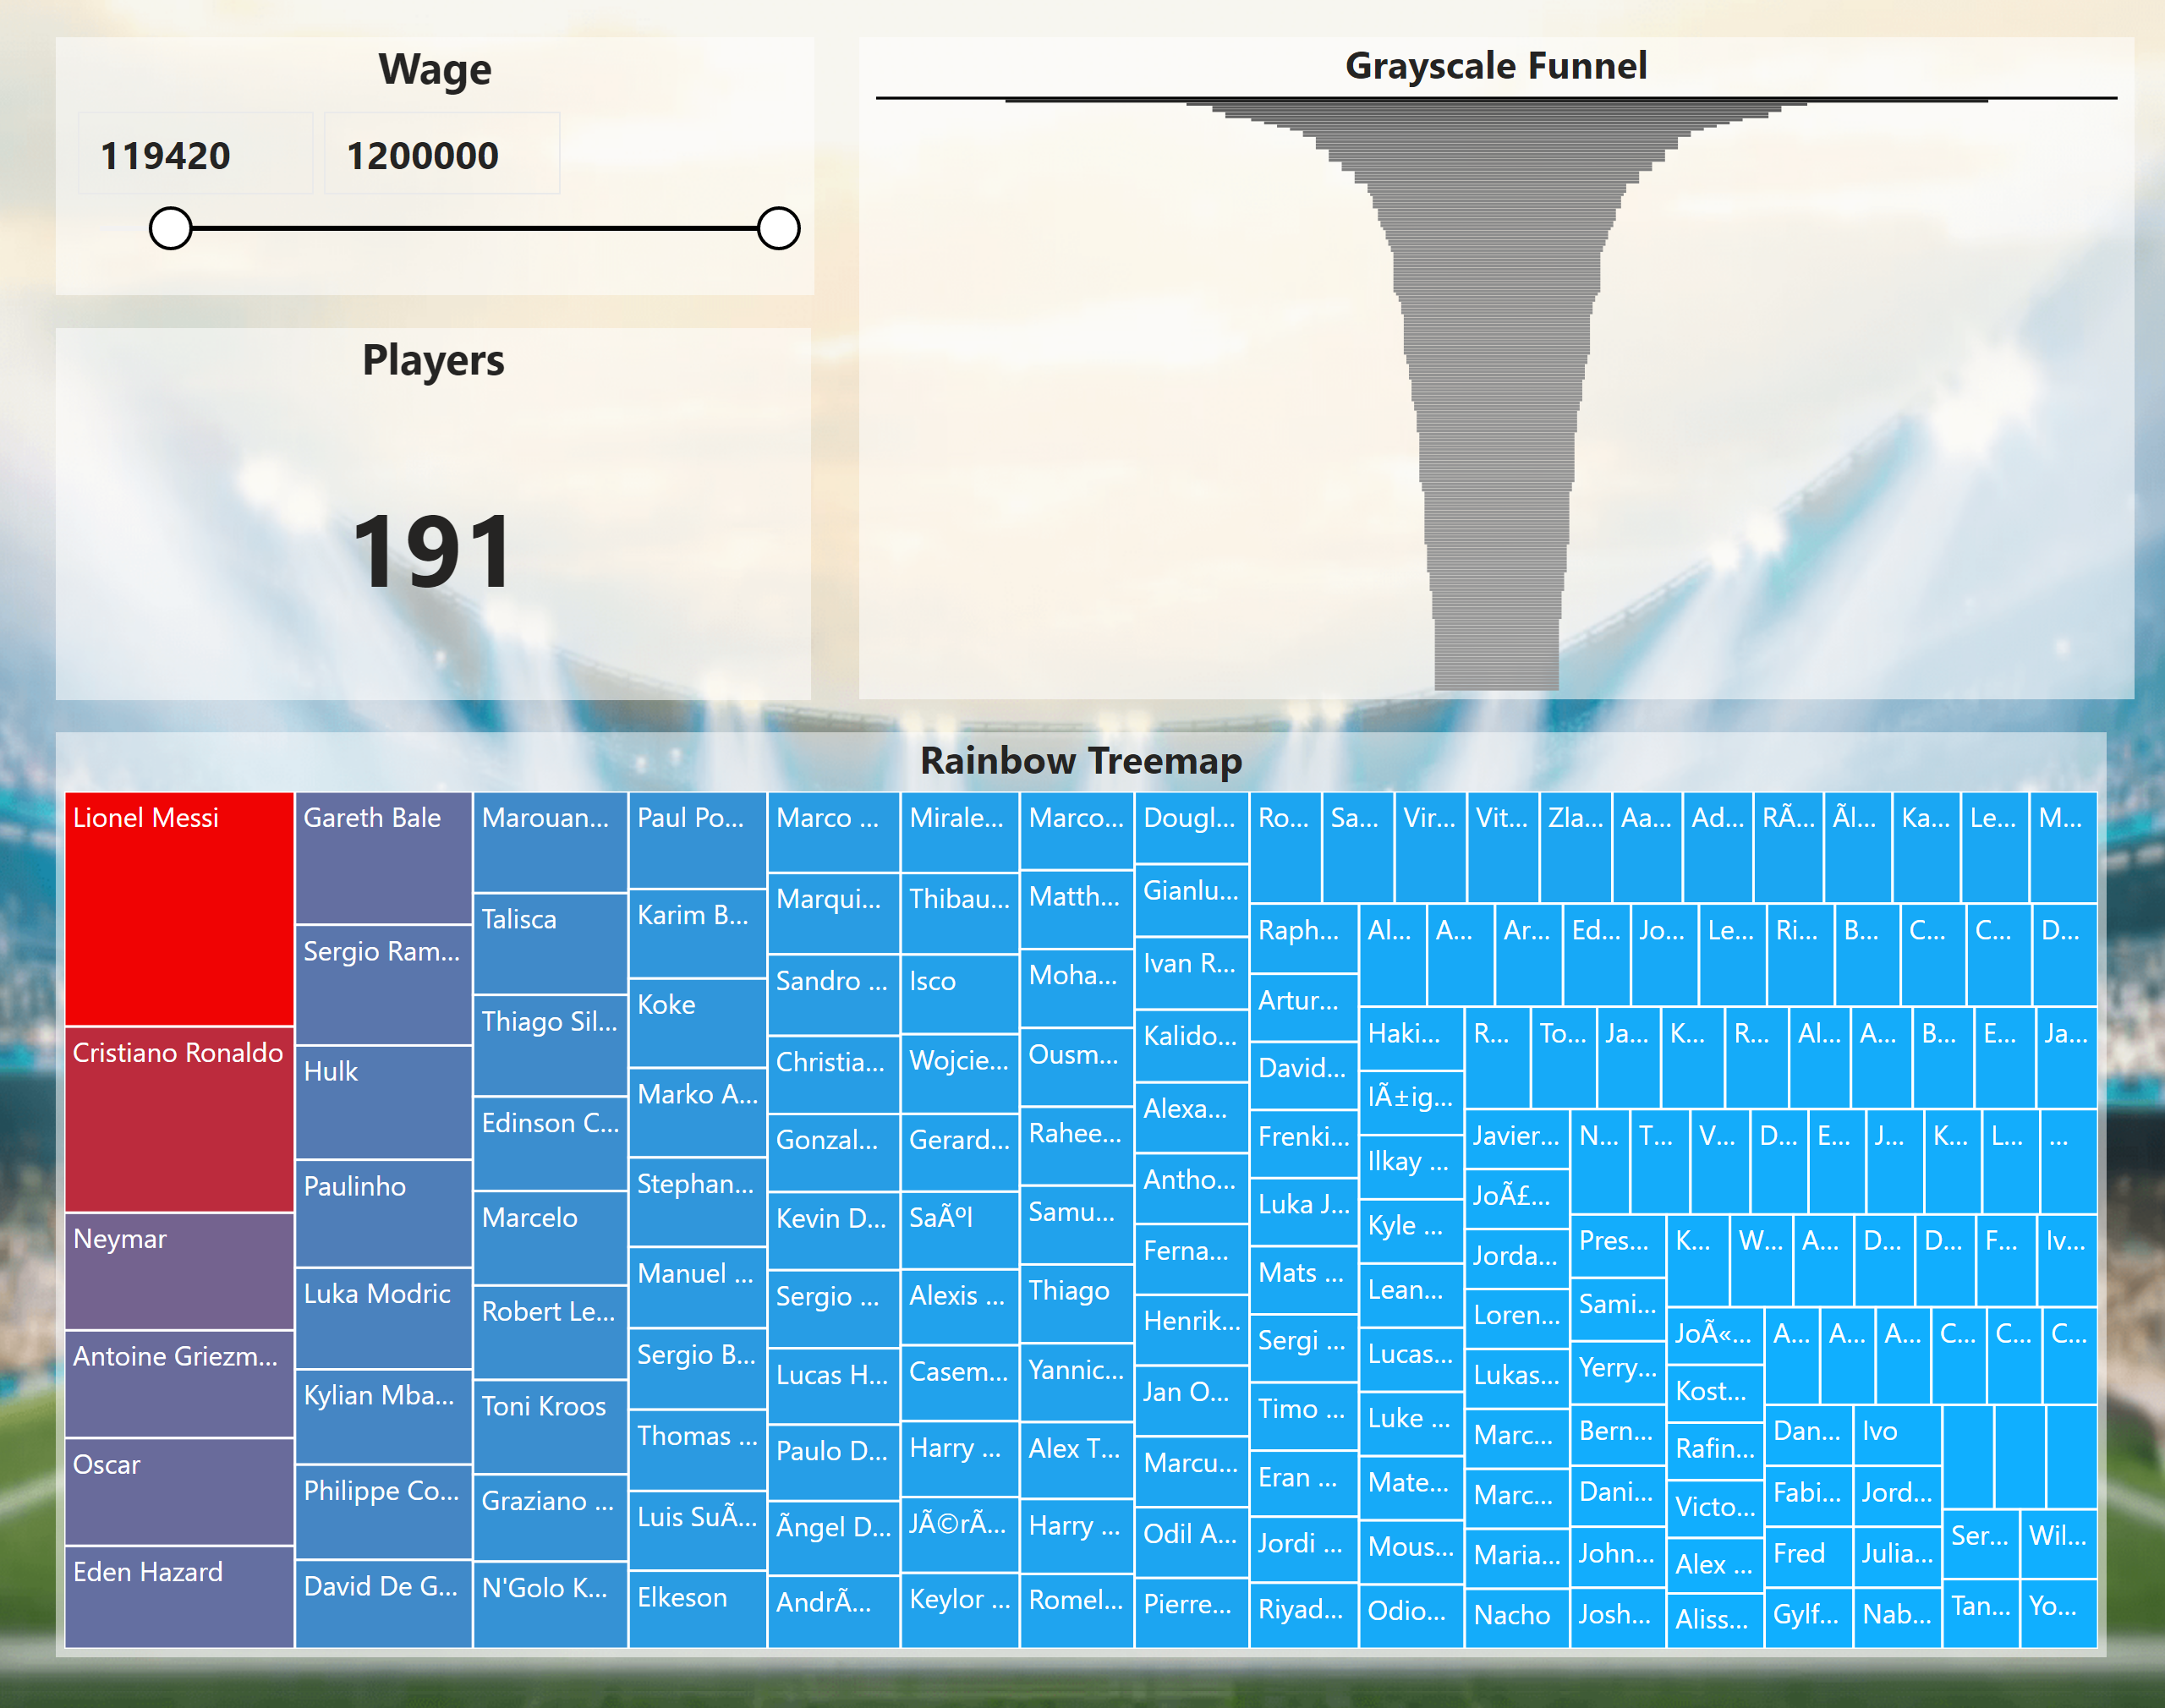
Notes:
Grayscale Funnel
No alt text provided
Rainbow Treemap
No alt text provided
Wage
No alt text provided
Players
No alt text provided

Slide 4
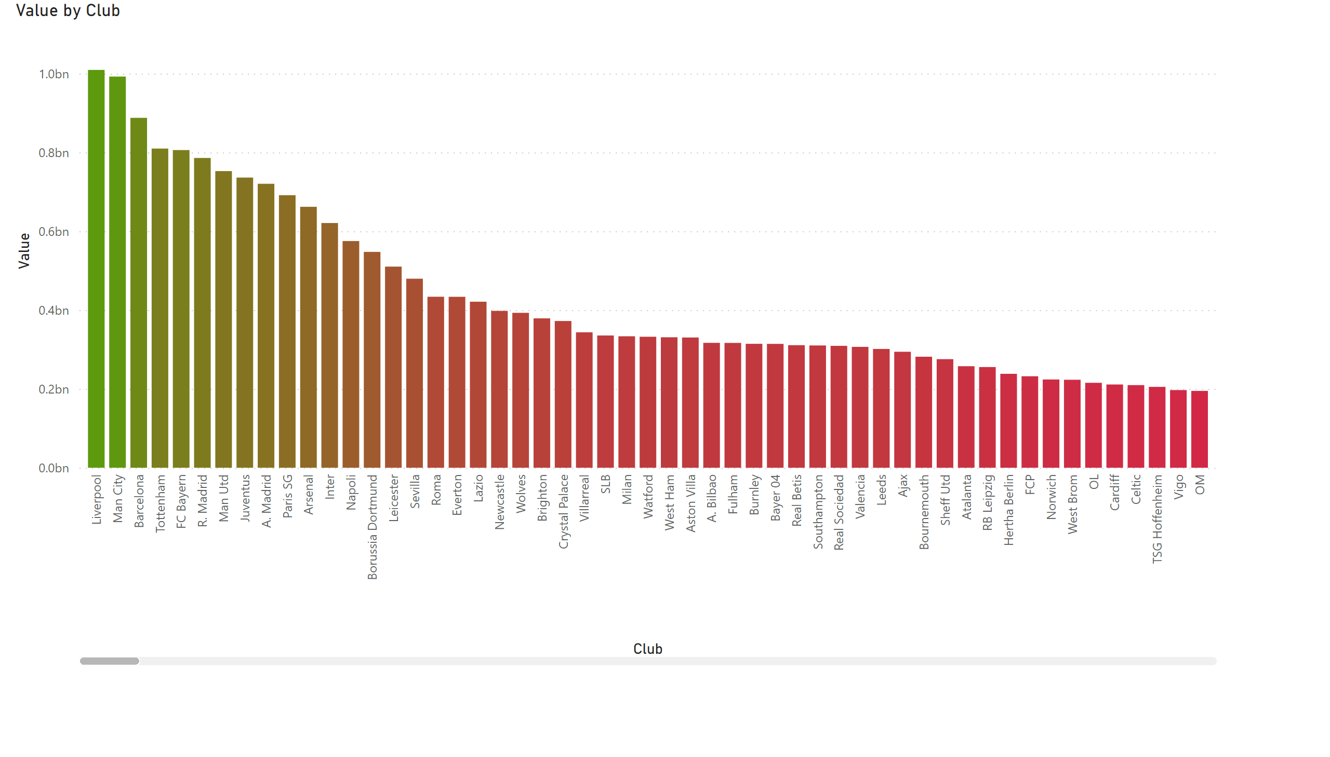
Notes:
lineStackedColumnComboChart
No alt text provided

Slide 5
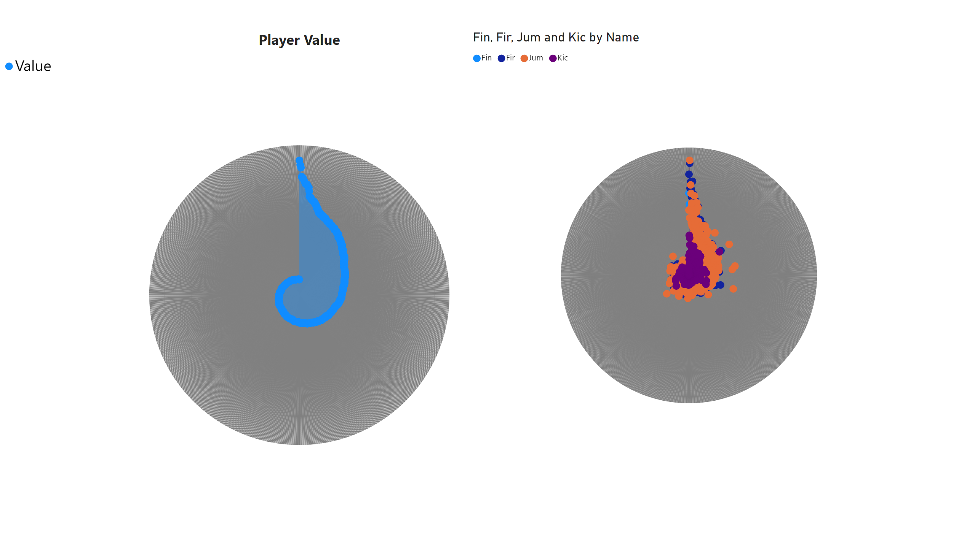
Notes:
Player Value
No alt text provided
RadarChart1446119667547
No alt text provided

Slide 6
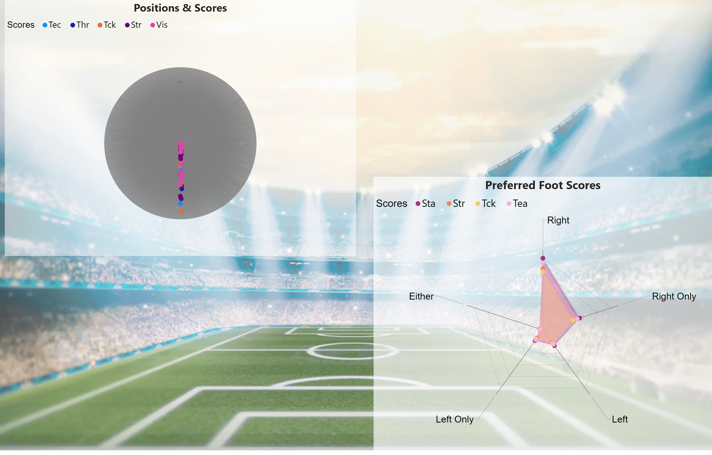
Notes:
Positions & Scores
No alt text provided
Preferred Foot Scores
No alt text provided

Slide 7
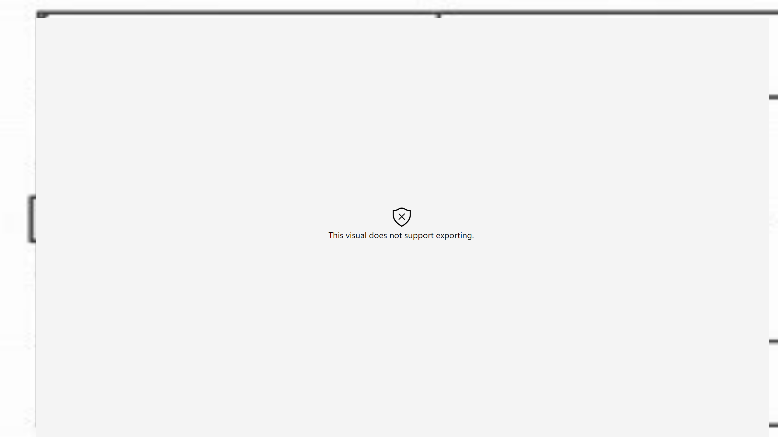
Displacment
Notes:
Field View
No alt text provided

Slide 8
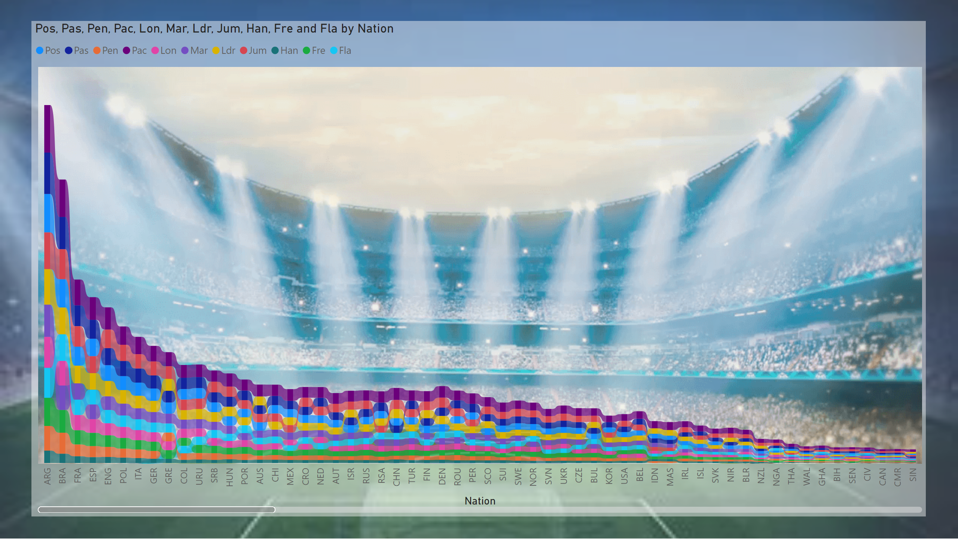
IV-543
Notes:
ribbonChart
No alt text provided

Slide 9
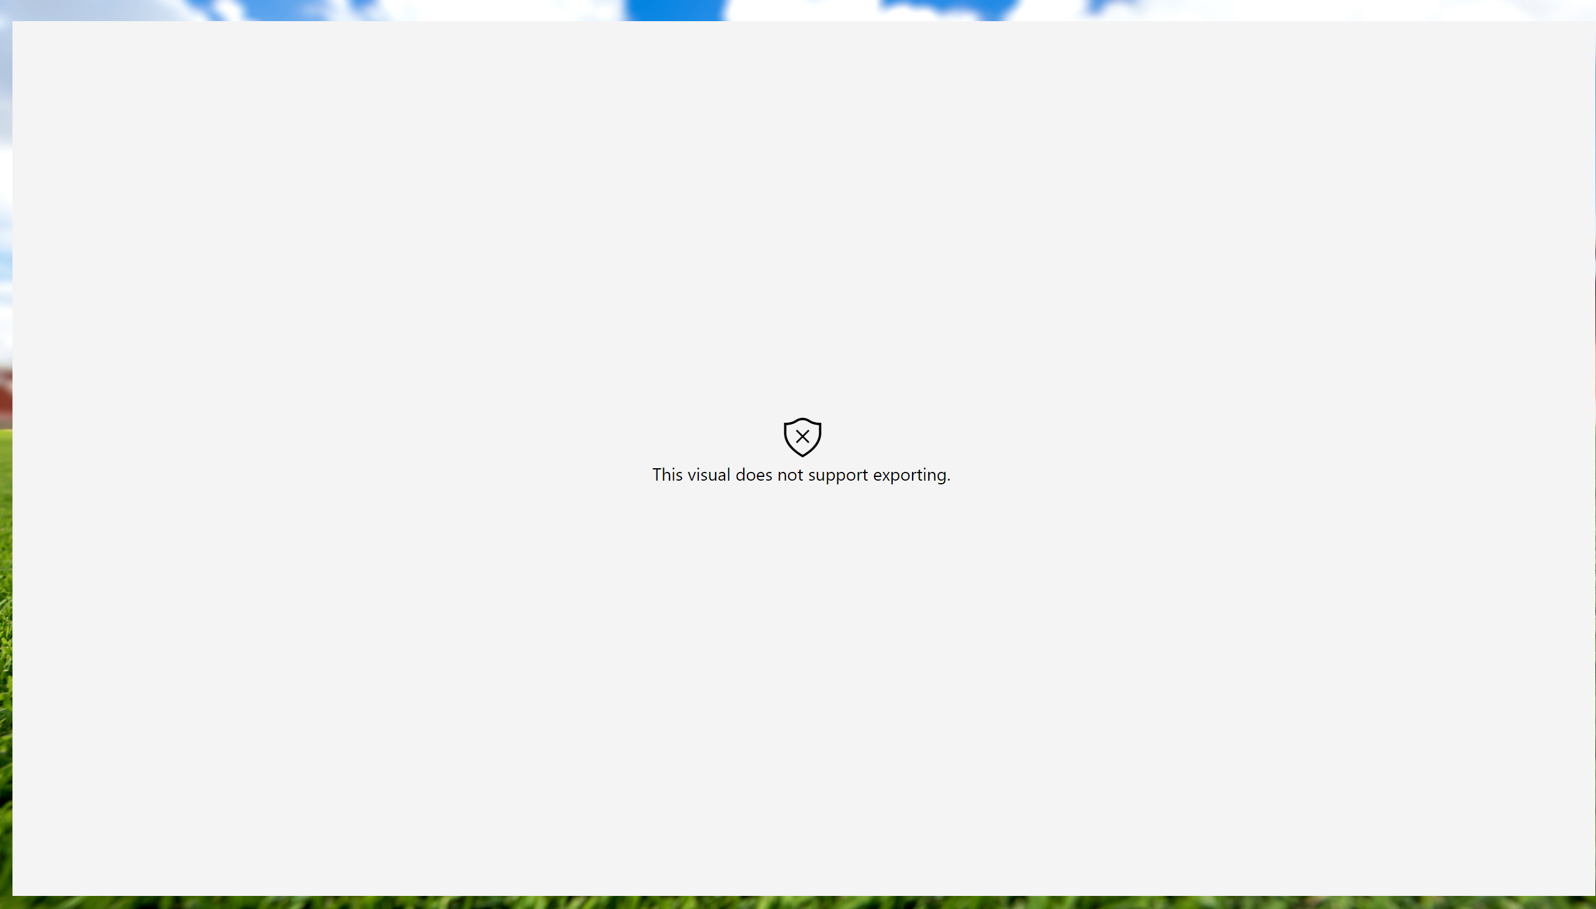
Tree
Notes:
wishyoulizationtassels
No alt text provided

Slide 10
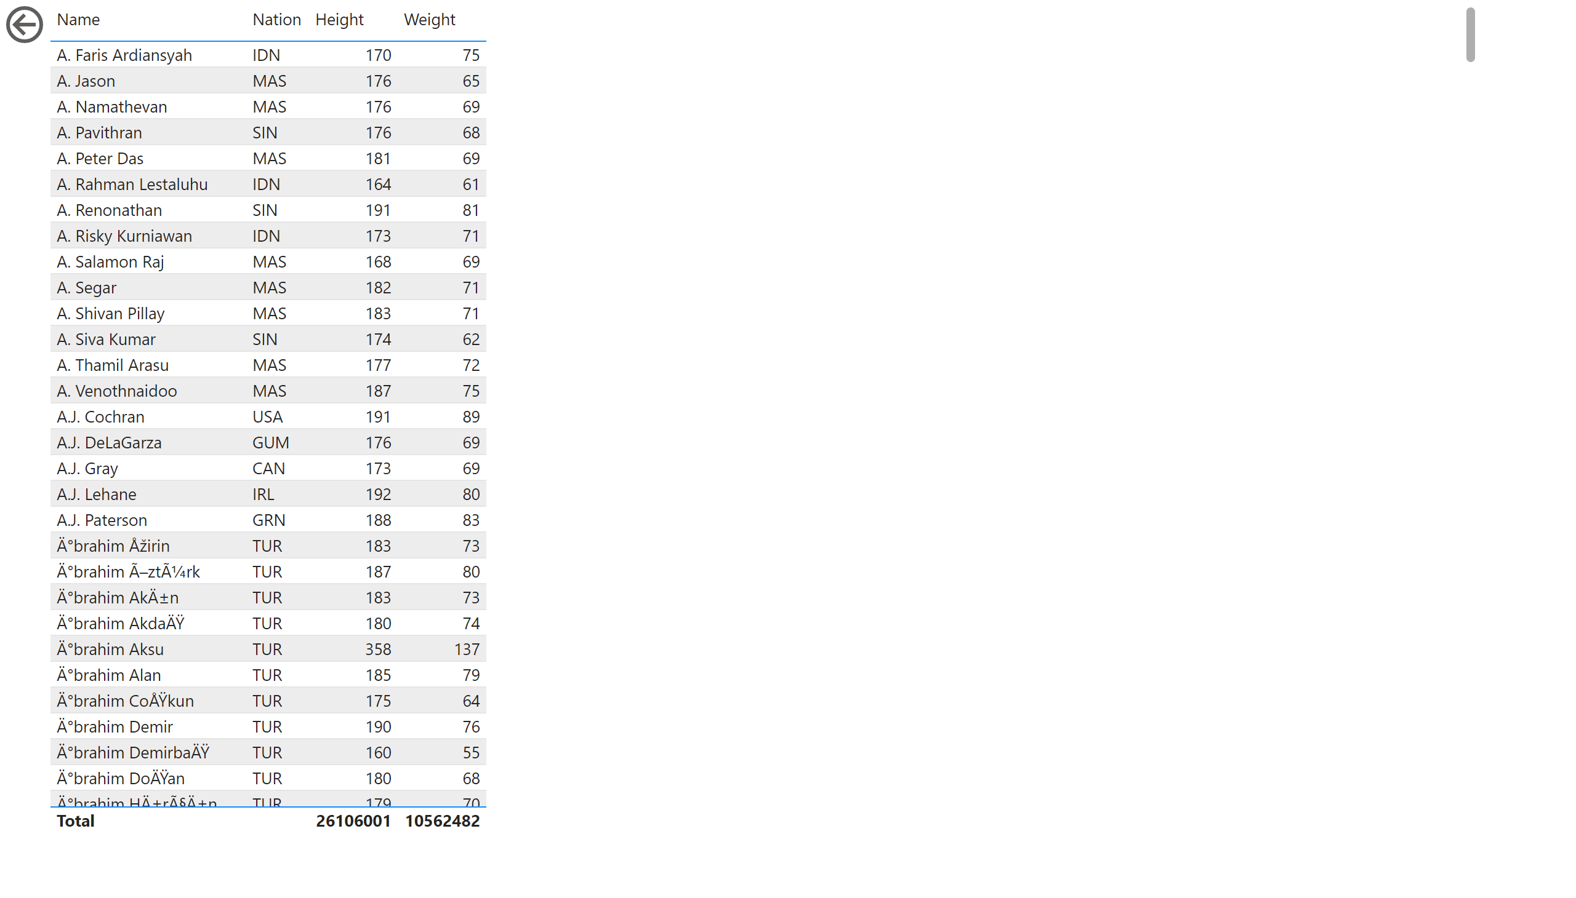
TV
Notes:
tableEx
No alt text provided
actionButton
No alt text provided

